Slide 1

V e n o m
String Project by

Slide 2
Our team
Miriam Kostadinova Georgieva​
- Scrum Trainer​
Ivan Dyankov Staev​
- Developer BackEnd
Marieta Petkova Stoycheva​
- Code Checker​
Martin Valentinov Martinov​
- Quality engineer
Teodora Nikolaeva Kompanska​
- Developer FrontEnd​

Slide 3
Stages of realization
First stage -planning
Second stage - realization
Third stage - presentation

Slide 4
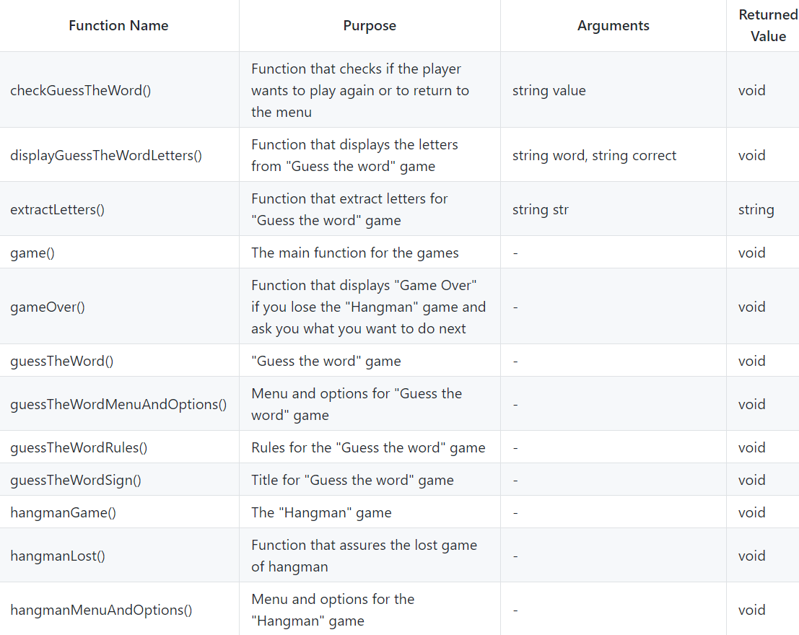
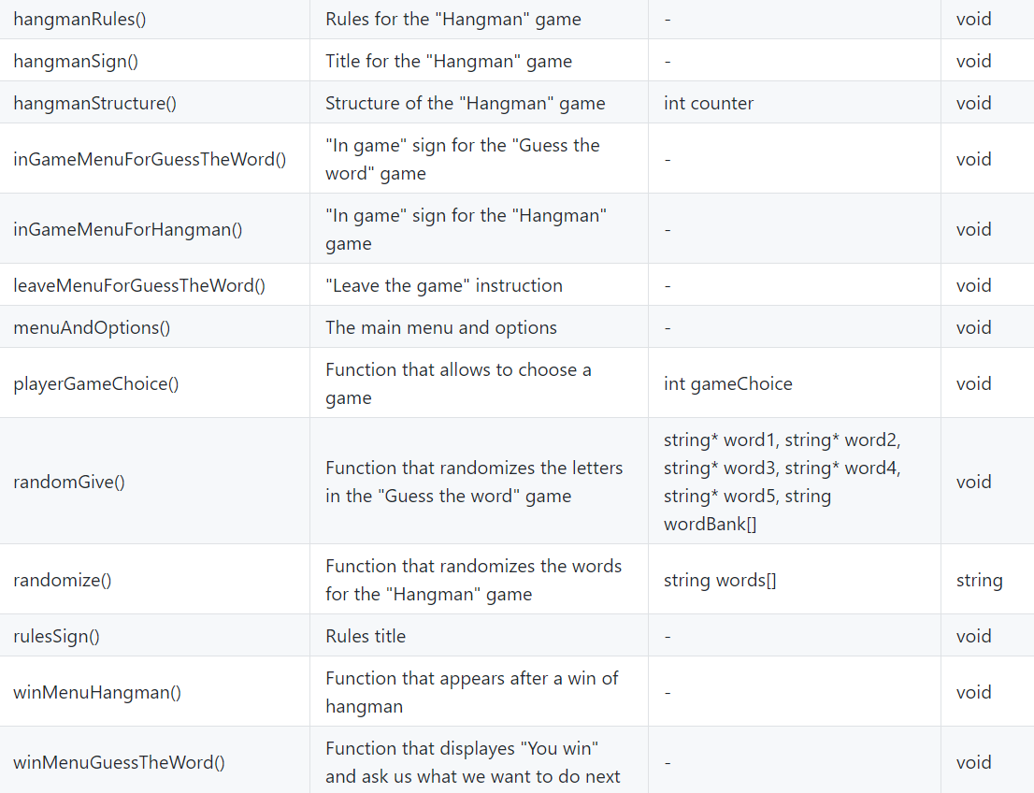
Functions we used

Slide 5






Programs we used

Slide 6

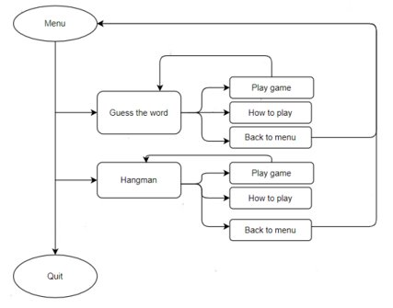
Flowchart of our program

Slide 7

How does the program work?

Slide 8
Thank you for your attention!

